Slide 1
Using Visual Aids
An ironic presentation.

Slide 2
Tip #1
Don’t use plain black text on plain white slides.
Your audience will be uninterested.
Your information will be ignored.
Your credibility will be questioned.

Slide 3
Tip #2
Don’t overdo it with colors, design and animation.
It can make your information hard to read.
It is distracting to your audience.

Slide 4
Tip #3
Proofread you’re information.
Make sure its correct.
Sight your sources.
Run a SPELL-CHECK!! PLEASE!!!
Capitalize proper nouns.
Punctuate correctly.

Slide 5
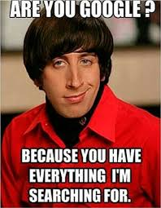
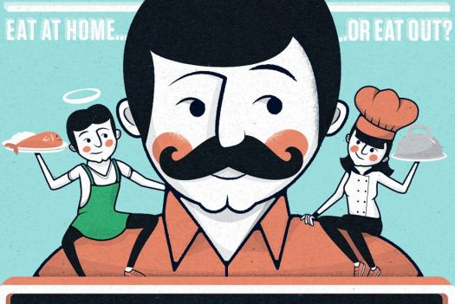
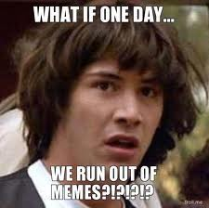
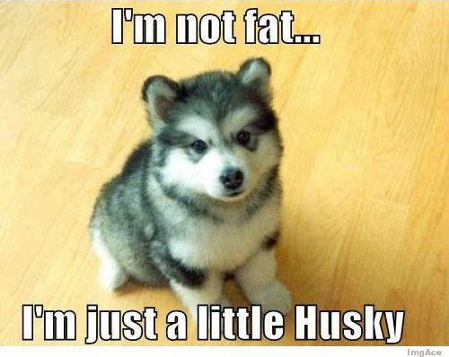
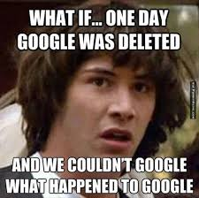
Tip #4
If using images, make sure they are purposeful.
Some images can be distracting to both you AND your audience.

Slide 6
Tip #5
Less is more.
Limit your visual aids to increase the impact they have on the audience.
In a 4-6 minute speech, you should have no more than 3-4 visual aids/slides/images.
Ensure you know how to move from image to image BEFORE you give the speech.

Slide 7
Final Tip
Practice!!
Practice!!
Practice!!
Know what your visual aids are, how to talk about them and WHY you are using them.
If they do not serve a clear purpose, they should not be a part of your speech.

Slide 9
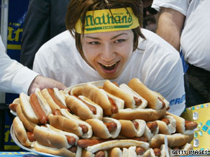
Competitive Eating
Example: “Games of the World in 60 Seconds”

Slide 10
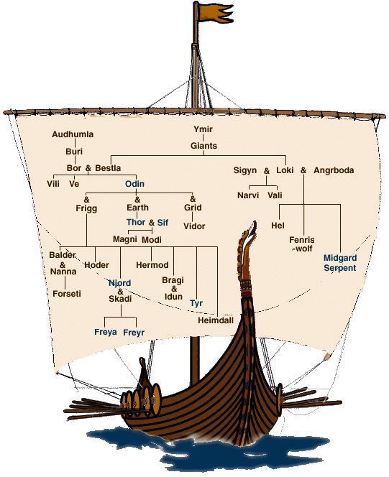
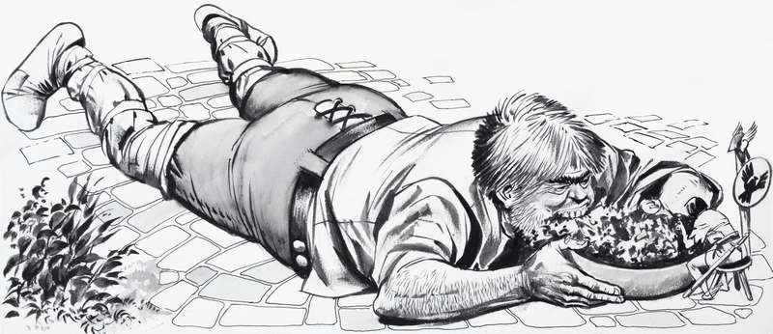
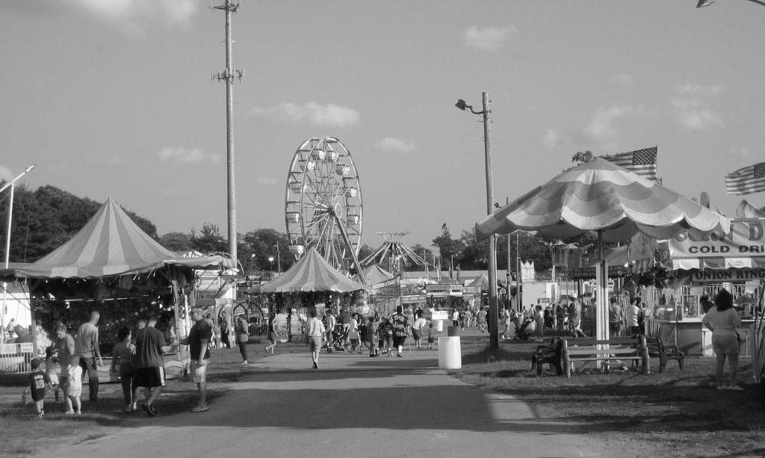
Origin
Notes:
2-3 level

Slide 11
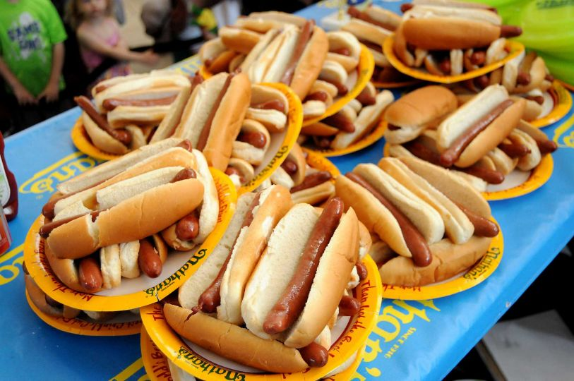
Objective
Notes:
2 level

Slide 12
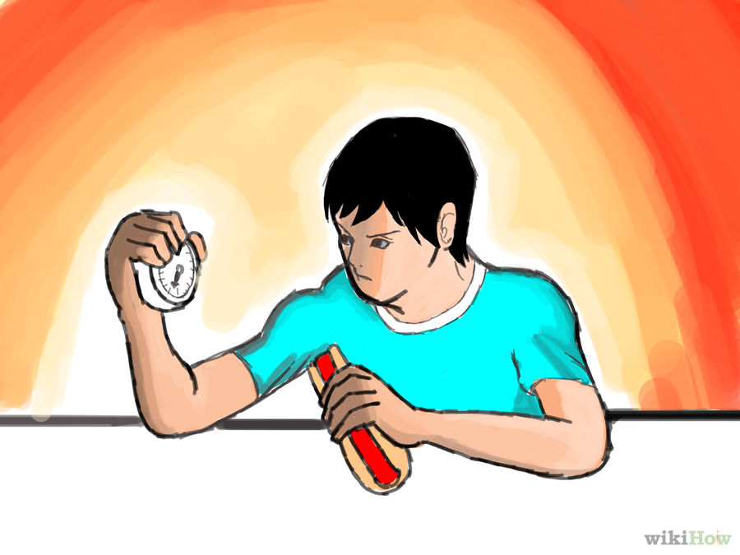
Rules
Notes:
3 level

Slide 13
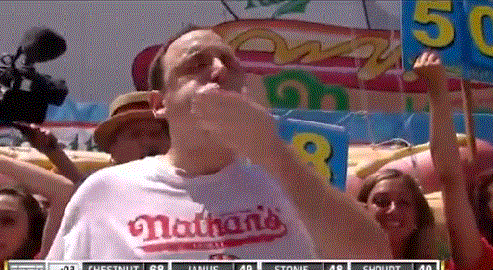
Person of Interest
Joey Chestnut
Notes:
3-4 level

Slide 14
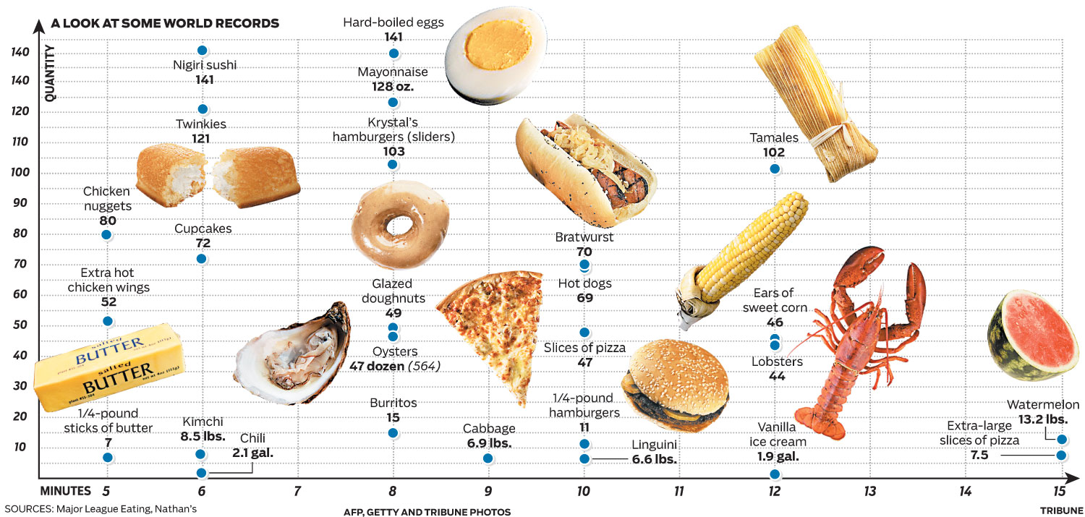
Fun Facts
Notes:
3-4 level

Slide 15
Works Cited
Blitz, Matt. "The Origin of Competitive Eating Contests." Today I Found Out. 10 June 2014. Web. 15 Nov. 2015.
Park, Madison. "Speed Eaters Gain Weight, Clog Arteries but Have Few Regrets." CNN. Cable News Network, 3 July 2009. Web. 15 Nov. 2015.
Quinto, Nadir. "Classic Illustrations from Norse Mythology." Classic Illustrations from Norse Mythology. Web. 15 Nov. 2015.
"The Wide World of Competitive Eating." -- Chicago Tribune. Tribune Graphics. Web. 15 Nov. 2015.

Slide 16
Visual Aid Rubric
 | Developing 1 | Capable 2 | Proficient 3 | Mastery 4
Visual Aid | Visual is distracting, cliched, and or demonstrates little thought | Simple and straightforward. Not distracting, but struggles to communicate a message | Clear and coherent. Layout is thought out and communicates the message clearly | Clear, coherent, creative, and unique. Layout is interesting, useful and presented in a way that enhances message

Slide 17
Level 1: Why?
Notes:
Distracting, incoherent. Doesn’t match message. Pixelated and disjointed.

Slide 18
Objective
Level 2: Why?
Notes:
Simple and straightforward. Not distracting but doesn’t necessarily add to presentation

Slide 19
Rules
Level 3: Why?
Notes:
Clear, coherent, multiple types of images (gif), transitions enhance message

Slide 20
Person of Interest
Level 4: Why?
Joey Chestnut
Notes:
Clear, coherent, unique (gif and chart) and transitions. Information is interesting and useful.

