Slide 1
Evaluating Credible Sources

Slide 2
Who is the Author?
Credible sources are written by authors respected in their fields of study. Responsible, credible authors will cite their sources so that you can check the accuracy of and support for what they've written. (This is also a good way to find more sources for your own research.)

Slide 3
How recent is the source?
The choice to seek recent sources depends on your topic. While sources on the American Civil War may be decades old and still contain accurate information, sources on information technologies, or other areas that are experiencing rapid changes, need to be much more current.

Slide 4
What is the author’s purpose?
When deciding which sources to use, you should take the purpose or point of view of the author into consideration. Is the author presenting a neutral, objective view of a topic? Or is the author advocating one specific view of a topic? Who is funding the research or writing of this source? A source written from a particular point of view may be credible; however, you need to be careful that your sources don't limit your coverage of a topic to one side of a debate.

Slide 5
What type of source does your audience value?
If you are writing for a professional or academic audience, they may value peer-reviewed journals as the most credible sources of information. If you are writing for a group of residents in your hometown, they might be more comfortable with mainstream sources, such as Time or Newsweek. A younger audience may be more accepting of information found on the Internet than an older audience might be.

Slide 6
Be especially careful when evaluating internet sources!
Never use Web sites where an author cannot be determined, unless the site is associated with a reputable institution such as a respected university, a credible media outlet, government program or department, or well-known non-governmental organizations. Beware of using sites like Wikipedia, which are collaboratively developed by users. Because anyone can add or change content, the validity of information on such sites may not meet the standards for academic research.

Slide 7
Credible sources
http://www.usa.gov/
http://www.bbc.co.uk/
www.si.edu/
www.Infoplease.com/

Slide 8
Questionable sources
www.wikipedia.com
www.tmz.com
http://www.nationalenquirer.com/
Also, make sure your “news” site is not satirical in nature:
www.theonion.com
http://dailycurrant.com/
https://www.youtube.com/watch?v=AFEwwG7rq0E

Slide 9
Scholarly Journal Articles

Slide 10
WHAT is a scholarly journal?
Scholarly Journals are journals which are respected for the research and information they provide about the topic they cover. They are written by and for people who have experience in a discipline or field. The research is often refereed meaning that it is reviewed by other researchers who are knowledgeable about the topic of the article. They usually have a more serious look than most popular magazines and contain graphs and charts but do not usually have many pictures. Scholarly journals cite their sources using footnotes or bibliographies.
(Penn State Great Valley Library - Penn State Great Valley - Penn State University)

Slide 11
WHERE do I find scholarly journals?
On the Media Center Website
Subscription Databases
Magazine/Newspapers/Reference
CQ Researcher
EBSCOhost Web
EBSCO Student Research Center
EBSCO Points of View
GALE Databases (formerly Infotrac)

Slide 12
HOW do I search my topic?
Choose a database
In the search box, type key words related to your topic

Slide 13
Example - Censorship
I chose the EBSCO Student Research Center
In the search bar, I typed “censorship”
In the options, I clicked “Full Text”
This ensures that I will only get results that have the full article available

Slide 14
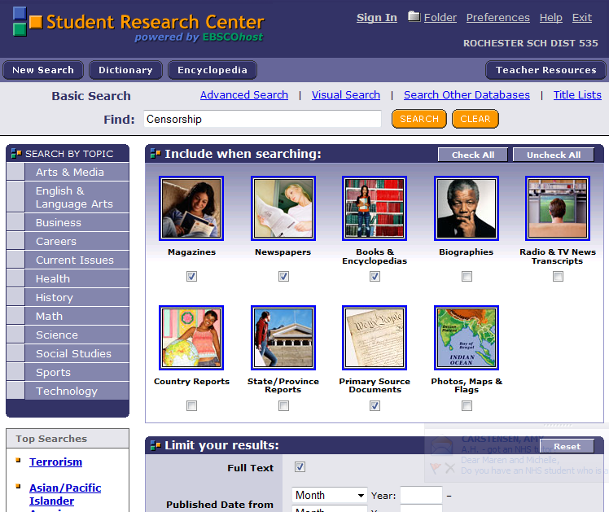

Slide 15
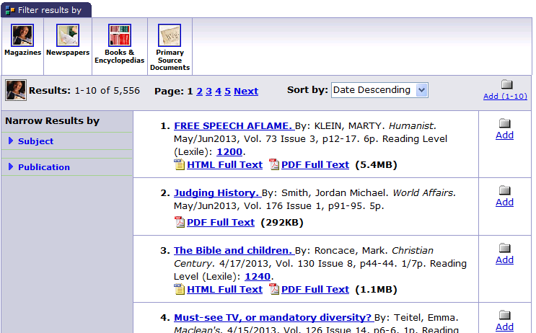
Results – 5,556!!
I can choose to filter these by type of result or I can start searching through the results to find articles that are relevant to my topic.

Slide 16
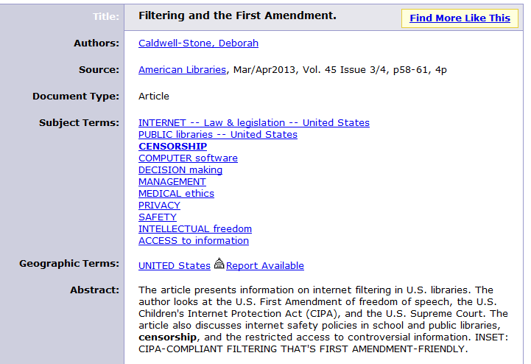
Choose an article
The ABSTRACT will give you a brief summary of the article so you can quickly decide if you want to keep it or keep searching.

Slide 17
Options!
You can do a number of things with the article
If you do not have access to a printer, you can email the article to yourself to print later

Slide 18
Printing
When you click print, you will see the option to estimate # of pages – DO THIS!! Don’t print 45 page articles!
On the right, you will see “Citation Format”
Choose MLA
Click Print

Slide 19
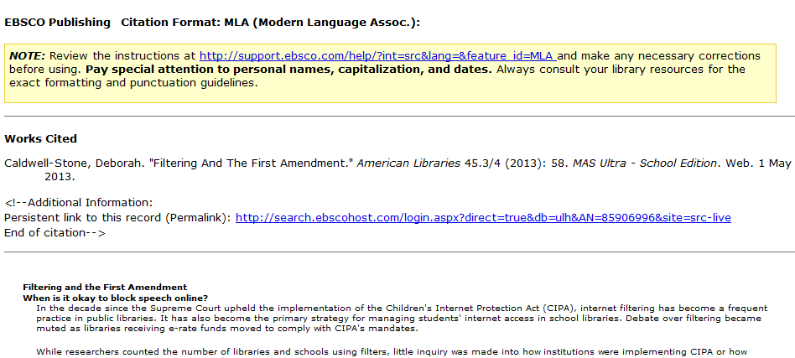
Look!
The database formats the citation for your Works Cited page FOR YOU!! ☺

Slide 20
Today…and beyond
You will have the rest of the hour to work on your topic brainstorm sheet
On Thursday:
You will be typing a 1 page topic proposal
In your topic proposal you should have:
1 paragraph describing the personal connection to your topic
1-2 paragraphs detailing your informative topic and what you already know about that topic
1 paragraph explaining how you are going to research further information – what source will you use? Be specific.

Slide 21
Tomorrow:
You will be typing a 1 page topic proposal
In your topic proposal you should have:
1 paragraph describing the personal connection to your topic
1-2 paragraphs detailing your informative topic and what you already know about that topic
1 paragraph explaining how you are going to research further information – what source will you use? Be specific.

